Slide 1
The Structure and Design of Randomized Control Trials (RCTs)

Slide 2
Outline for the Session
Why randomize?
How do I incorporate randomized evaluations into my research design?
Power calculations
What are the practical design and implementation issues?

Slide 3
Why Randomize?

Slide 4

The Problem of Causal Inference
The potential outcome (Rubin, 1974)
Average effect
$$E\left[δ\right]=E\left[Y_{i}^{T}−Y_{i}^{C}\right]$$

Slide 5

The Problem of Causal Inference
The potential outcome (Rubin, 1974)
Treatment effect
$$E\left[δ\right]=E\left[Y_{i}^{T} | T\right]−E\left[Y_{i}^{C} | C\right]$$

Slide 6
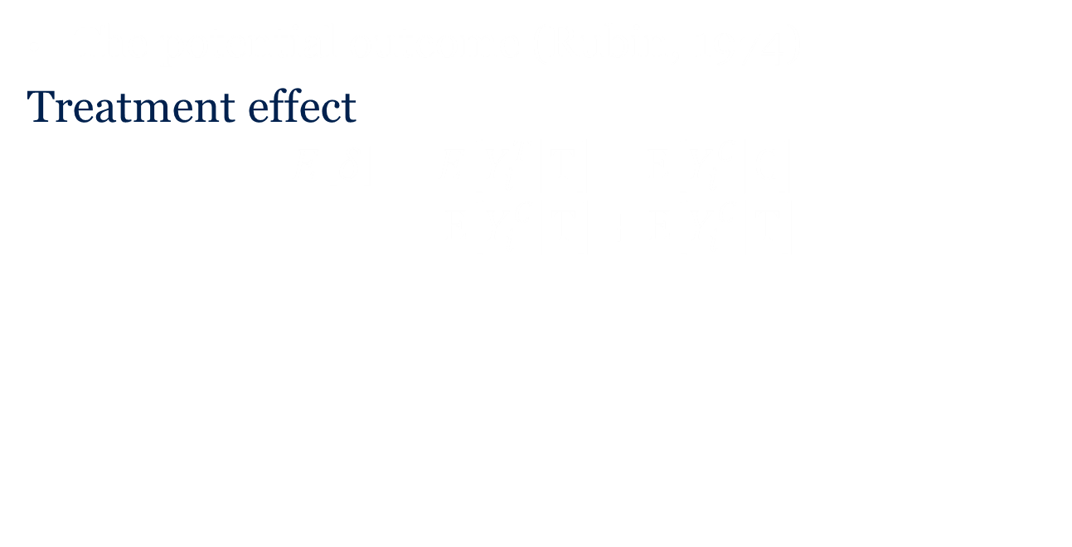
The Problem of Causal Inference
The potential outcome (Rubin, 1974)
Treatment effect
$$E\left[δ\right]=E\left[Y_{i}^{T} | T\right]−E\left[Y_{i}^{C} | C\right]$$
$$−E\left[Y_{i}^{C} | T\right]+E\left[Y_{i}^{C} | T\right]$$

Slide 7
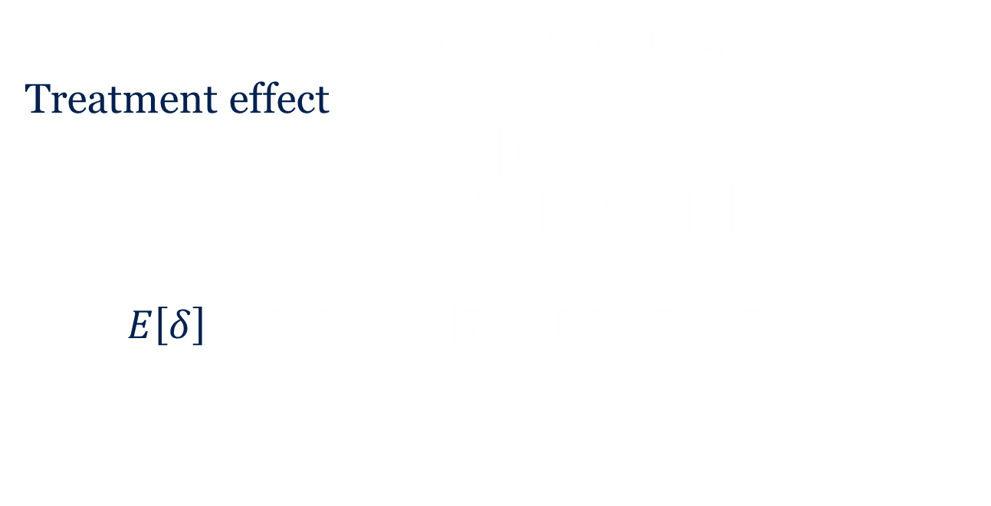
The Problem of Causal Inference
The potential outcome (Rubin, 1974)
Treatment effect
$$E\left[δ\right]=E\left[Y_{i}^{T} | T\right]−E\left[Y_{i}^{C} | C\right]$$
$$−E\left[Y_{i}^{C} | T\right]+E\left[Y_{i}^{C} | T\right]$$
$$E\left[δ\right]=E\left[Y_{i}^{T}−Y_{i}^{C} | T\right]+E\left[Y_{i}^{C} | T\right]−E\left[Y_{i}^{C} | C\right]$$

Slide 8
The Problem of Causal Inference
The potential outcome (Rubin, 1974)
Treatment effect
$$E\left[δ\right]=E\left[Y_{i}^{T} | T\right]−E\left[Y_{i}^{C} | C\right]$$
$$−E\left[Y_{i}^{C} | T\right]+E\left[Y_{i}^{C} | T\right]$$
$$E\left[δ\right]=E\left[Y_{i}^{T}−Y_{i}^{C} | T\right]+E\left[Y_{i}^{C} | T\right]−E\left[Y_{i}^{C} | C\right]$$
Treatment Effect
Selection Bias

Slide 9
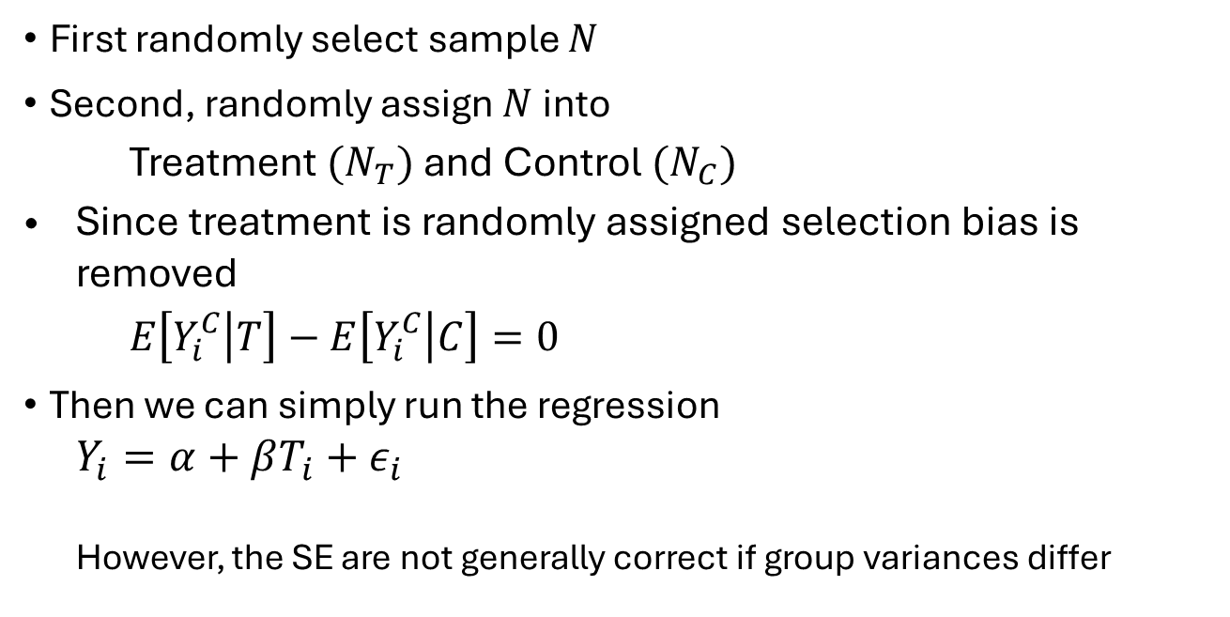
Randomization Solves the Selection Bias
First randomly select sample $N$
Second, randomly assign $N$into
Treatment $(N_{T})$ and Control $(N_{C})$
Since treatment is randomly assigned selection bias is removed
$E\left[Y_{i}^{C} | T\right]−E\left[Y_{i}^{C} | C\right]=0$
Then we can simply run the regression
$$Y_{i}=α+βT_{i}+ε_{i}$$
However, the SE are not generally correct if group variances differ

Slide 10
Caveats
(Reminder) This requires two assumptions
SUTVA (Stable Unit Treatment Value Assumption)
“no spillovers”
Unconfoundedness/Ignorability
“assignment to treatment is independent of outcome”
In most cases only partial randomization occurs
Population of study is not nationally representative but chosen conditional on some observables (poverty, age, gender, etc.)

Slide 11
Incorporating Randomized Evaluations in a Research Design

Slide 12
Preparing to Run a Field Experiment
Use theory to guide your design
Understand the local context
Obtain sufficient sample size

Slide 13
1. Use Theory to Guide Your Design
Theory allows appropriate nulls to be tested, designs to be efficient, and the ‘whys’ to be answered
Theory is portable, many empirical results are not
It may suggest generalizability

Slide 14
An Example
Go beyond A/B experiments to test economic theory
List, 2004
Why do people receive different price quotes for the same good?
Economists have two major theories
Discrimination
Search Costs

Slide 15
Discrimination NFE
12 disabled and 12 non-disabled testers approached various body shops in Chicago with different cars (identical cars across disabled and abled) that were in need of repair
Offer differences:
Disabled receive prices 30% higher than the non-disabled receive

Slide 16
Complementary Evidence
So what?
We find that price differences exist
But why? Is it search costs or discrimination?
New Treatment
Re-send different pairs to receive price quotes
One treatment replicates above treatment
Another treatment is identical except that it has both agent types explicitly noting that “I’m getting a few price quotes today

Slide 17
Replication Treatment

Slide 18
“Few Quote” Treatment

Slide 19
2. Understand the Local Context
Be an expert about the market that you are studying
What incentivizes people in your study/context may not be the same as what incentivizes others
Interpreting results from an intervention is quite difficult if you don’t understand subjects’ underlying motivations

Slide 20
Potential Hurdles: Political
Political difficulties
Politicians like to reward supporters. They have ideas about where they would like a project to go and may be reluctant to randomize
Individuals in the control group may be angry that they are not in the treatment group
NGOs and private companies may have areas they want to target and want to choose the treated group

Slide 21
Potential Hurdles: Ethical
Ethical issues
Analogous to clinical trails--withholding the treatment from the control group
When treatment demonstrated effective, make it available to the control group (worms)

Slide 22
3. Obtain Sufficient Sample Size
You should have a sample size that allows you to make inference.
Using simple power tests allow you to know what is “sufficient size” before you run your experiment.
Fewer researchers realize that even when you reject nulls power matters – at least you can then estimate bounds of the possible effect.

Slide 23
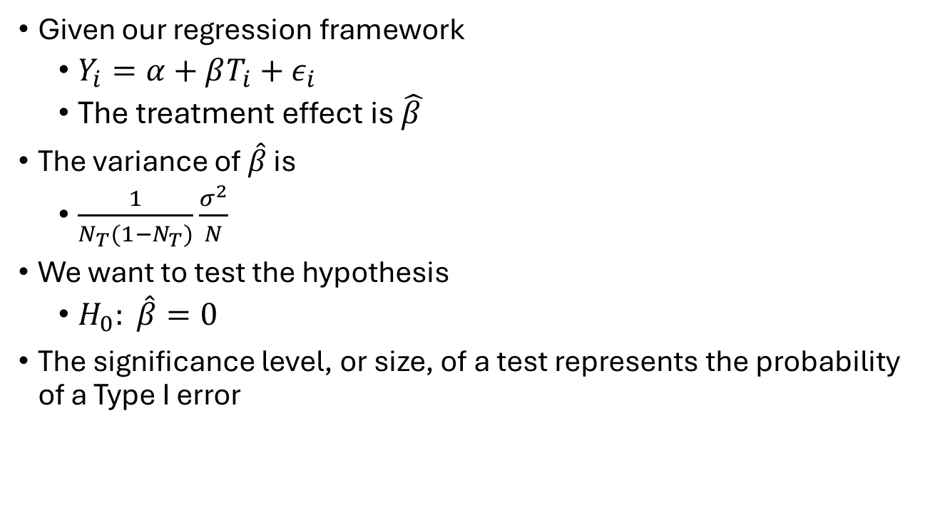
Basic Principles of Power Calculations
Given our regression framework
$Y_{i}=α+βT_{i}+ε_{i}$
The treatment effect is $\hat{β }$
The variance of $\hat{β}$ is
$\frac{1}{N_{T}(1−N_{T})}\frac{σ^{2}}{N}$
We want to test the hypothesis
$H_{0}: \hat{β}=0$
The significance level, or size, of a test represents the probability of a Type I error

Slide 24
Error Types and Power
Type I
We reject the hypothesis when it is in fact true
False positive (probability = α)
Type II
We fail to reject the hypothesis when it is in fact false
False negative (probability = κ)
Power
is the probability of rejecting a false null hypothesis
True positive (probability 1 – κ)
That is, maximizing statistical power is to minimize the likelihood of committing a type II error.
Notes:
A good resource: https://www.povertyactionlab.org/resource/power-calculations

Slide 25
Power Calculations
Power calculations ask: if the alternative hypothesis is true, then what is the probability that the estimated coefficient lies outside the 95% CI defined under the null?
They involve either determining the sample size (n) needed to detect the minimum detectable effect (MDE) given other parameters, or determining the effect size that can be detected given a set sample size and other parameters.

Slide 26
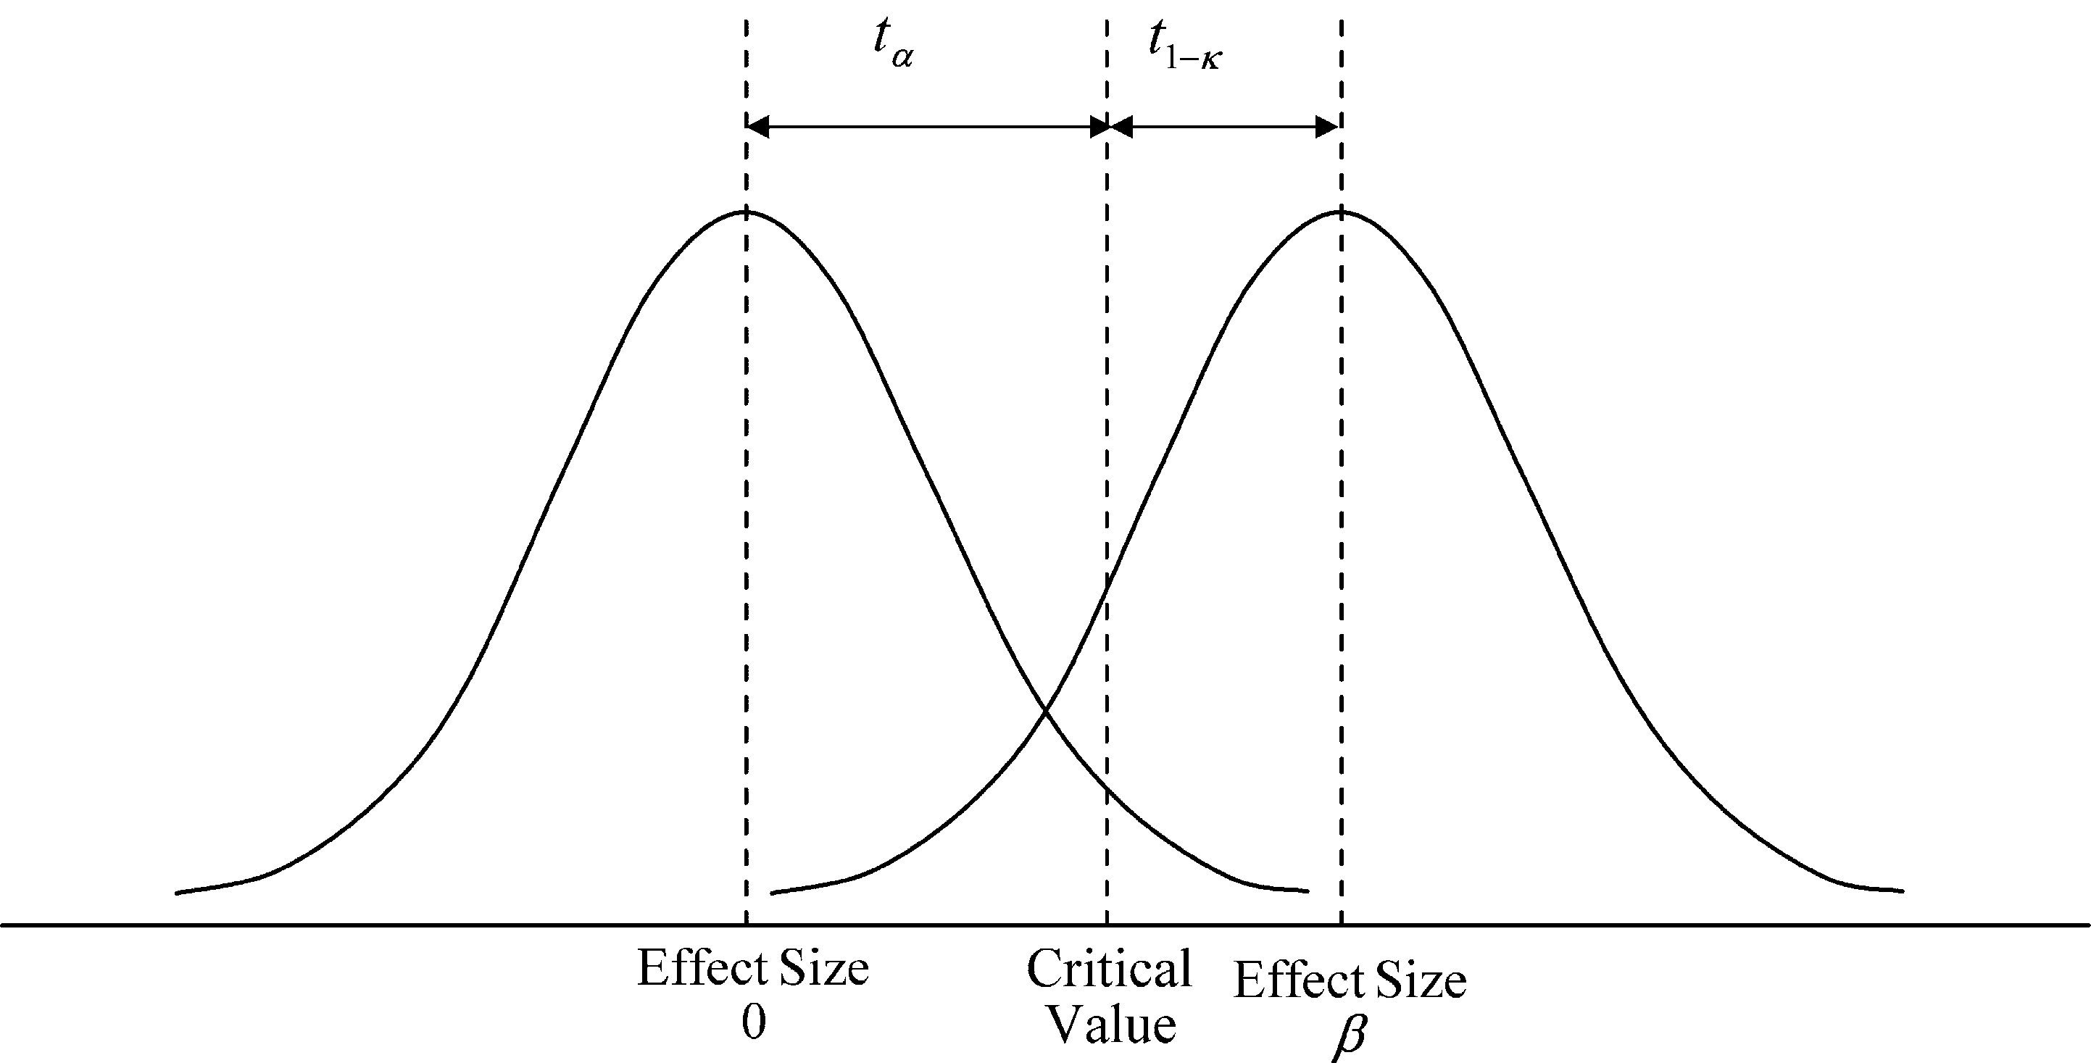

Hypothesis Testing
For a given significance level $H_{0}$ will be rejected if $\hat{β}$ falls to the right of a critical level $t_{a}$

Slide 27
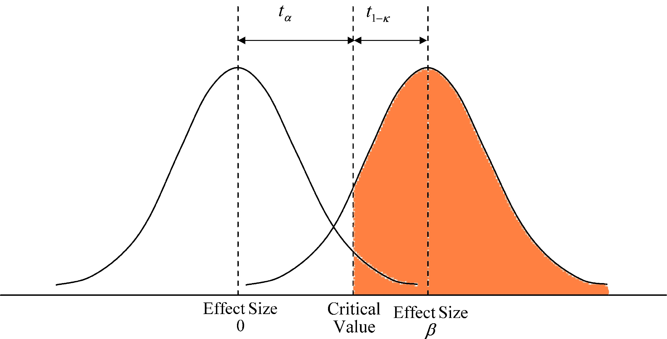

Hypothesis Testing
For a given significance level $H_{0}$ will be rejected if $\hat{β}$ falls to the right of a critical level $t_{a}$
The power of the test is the area to the right of $t_{a}$

Slide 28
Components of power calculations
Significance (α): The probability of committing a type I error. It is typically set at 5%, i.e., α=0.05.
Power (1-κ): Typically set at 0.8, meaning the probability of falsely failing to reject the null hypothesis is 0.2 or 20%. Power mirrors the significance level, α: as α increases (e.g., from 1% to 5%), the probability of rejecting the null hypothesis increases, which translates to a more powerful test.
Minimum detectable effect (MDE): The smallest effect that, if true, has (1-β)% chance of producing an estimate that is statistically significant at the α% level (Bloom 1995). In other words, the MDE is the effect size below which we may not be able to distinguish that the effect is different from zero, even if it is.
Sample size (N)
Variance of outcome variable (σ2)
Treatment allocation (N_{T}), the proportion of the sample assigned to the treatment group. Power is typically maximized with an equal split between treatment arms, though there are instances when an unequal split may be preferred.
Intra-cluster correlation coefficient (ICC): A measure of the correlation between observations within the same cluster, also often given as ρ. If the study involves clustered randomization (i.e., when each unit of randomization contains multiple units of observation), you will need to account for the fact that individuals (or households, etc.) within a group such as a town/village/school are more similar to each other than those in different groups. In general, this will increase the required sample size.

Slide 29
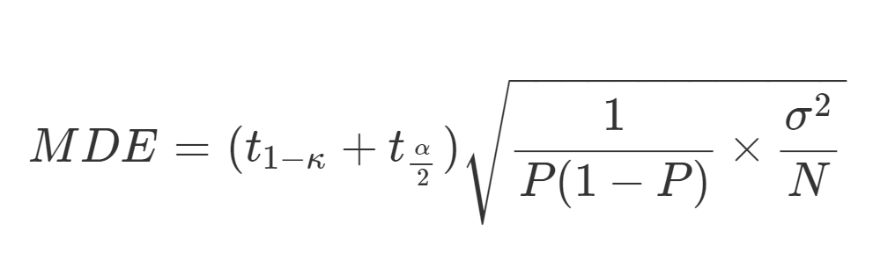
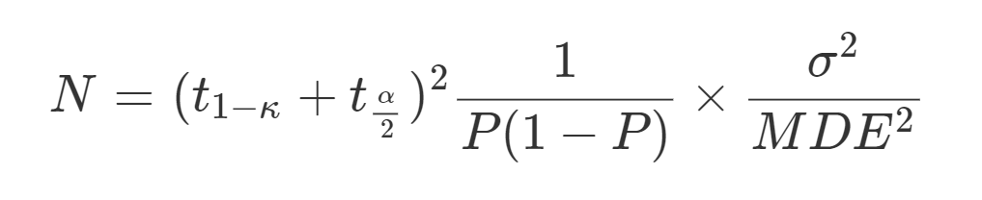


If sample size is fixed, can calculate the MDE
$$\frac{1}{N_{T}(1−N_{T})}$$
If MDE is known (or hypothesized), can calculate the N
$$\frac{1}{N_{T}(1−N_{T})}$$

Slide 30
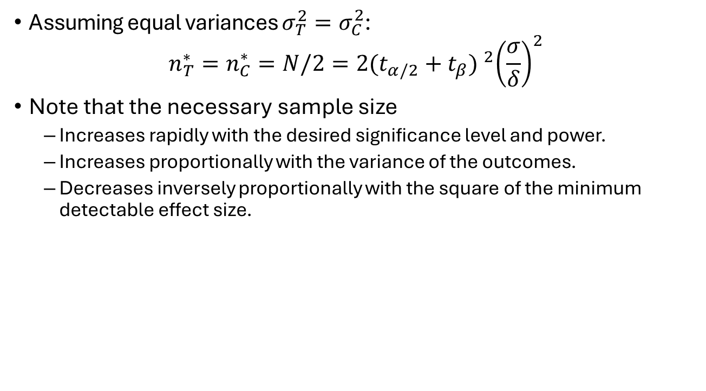
Sample Size “Rules of Thumb”
Assuming equal variances $σ_{T}^{2}=σ_{C}^{2}$:
$$n_{T}^{∗}=n_{C}^{∗}=N/2=2{(t_{α/2}+t_{β}) }^{2}{\left(\frac{σ}{δ}\right)}^{2}$$
Note that the necessary sample size
Increases rapidly with the desired significance level and power.
Increases proportionally with the variance of the outcomes.
Decreases inversely proportionally with the square of the minimum detectable effect size.

Slide 31

Sample Size “Rules of Thumb”
Assuming equal variances $σ_{T}^{2}=σ_{C}^{2}$:
$$n_{T}^{∗}=n_{C}^{∗}=N/2=2{(t_{α/2}+t_{β}) }^{2}{\left(\frac{σ}{δ}\right)}^{2}$$
Sample size depends on the ratio of effect size to standard deviation. Hence, effect sizes can just as easily be expressed in standard deviations.

Slide 32
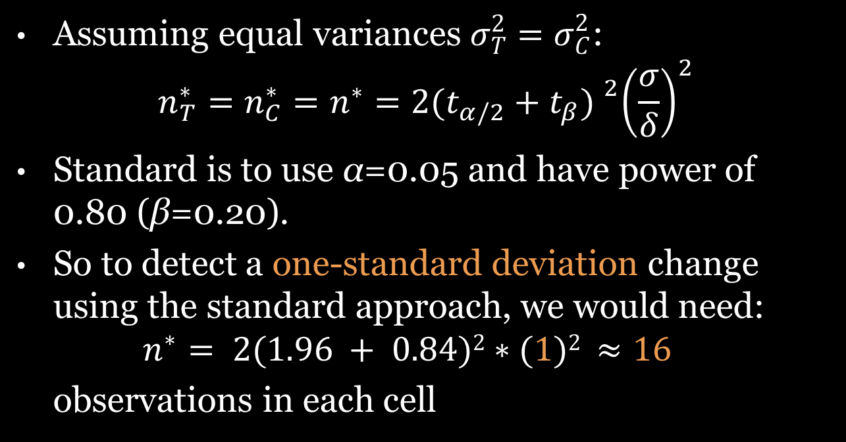
Sample Size “Rules of Thumb”
Assuming equal variances $σ_{T}^{2}=σ_{C}^{2}$:
$$n_{T}^{∗}=n_{C}^{∗}=n^{∗}=2{(t_{α/2}+t_{β}) }^{2}{\left(\frac{σ}{δ}\right)}^{2}$$
Standard is to use α=0.05 and have power of 0.80 (β=0.20).
So to detect a one-standard deviation change using the standard approach, we would need:
$$n^{∗}= 2(1.96 + 0.84)2∗(1)2 ≈16$$
observations in each cell

Slide 33
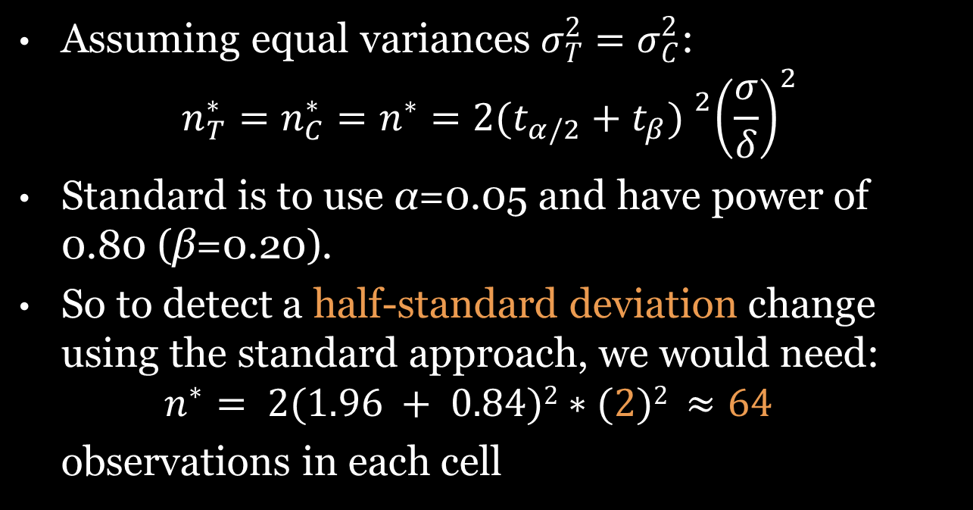
Sample Size “Rules of Thumb”
Assuming equal variances $σ_{T}^{2}=σ_{C}^{2}$:
$$n_{T}^{∗}=n_{C}^{∗}=n^{∗}=2{(t_{α/2}+t_{β}) }^{2}{\left(\frac{σ}{δ}\right)}^{2}$$
Standard is to use α=0.05 and have power of 0.80 (β=0.20).
So to detect a half-standard deviation change using the standard approach, we would need:
$$n^{∗}= 2(1.96 + 0.84)2∗(2)2 ≈64$$
observations in each cell

Slide 34
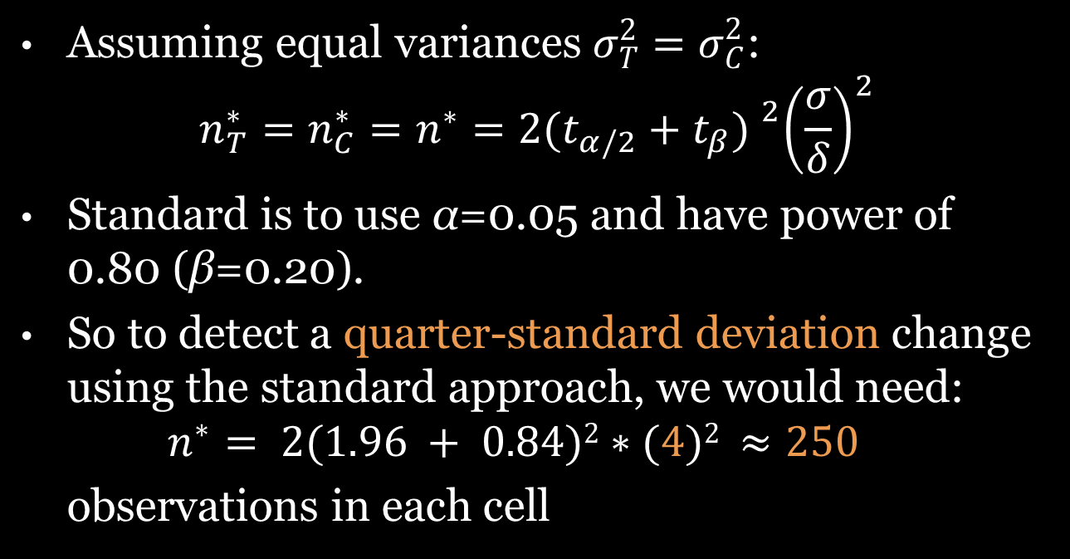
Sample Size “Rules of Thumb”
Assuming equal variances $σ_{T}^{2}=σ_{C}^{2}$:
$$n_{T}^{∗}=n_{C}^{∗}=n^{∗}=2{(t_{α/2}+t_{β}) }^{2}{\left(\frac{σ}{δ}\right)}^{2}$$
Standard is to use α=0.05 and have power of 0.80 (β=0.20).
So to detect a quarter-standard deviation change using the standard approach, we would need:
$$n^{∗}= 2(1.96 + 0.84)2∗(4)2 ≈250$$
observations in each cell

Slide 35
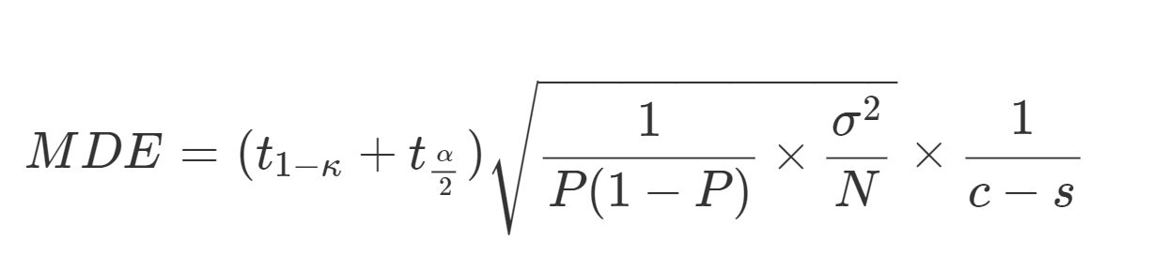
Things that Effect the Power
Grouped errors
Comparing between multiple groups reduces MDE
Imperfect compliance
Partial compliance reduces the MDE
Control variables
Controlling for baseline values increases the MDE
Stratification
Blocking into similar groups increases the MDE

Slide 36
Power Calculations in Practice
Many of the parameters in the power calculations are unknown
Need to know mean and variance in absence of experiment (get from previous lit)
Correlation of outcome of interest between groups (do calculations at a variety of levels).
The expected effect size
Budgets are usually the binding constraint
Use the power calculations to help optimally design the experiment within the given budget constraint

Slide 37
For next class
run jupyter notebook on power calcs (and play around with the parameter values)
Notes:
Other power calc software: https://wtgrantfoundation.org/optimal-design-with-empirical-information-od

Slide 38
Practical Design and Implementation Issues

Slide 39
Unit of Randomization
Randomizing at the individual level
Randomizing at the group level “Cluster Randomized Trial”
Which level to randomize?
What unit does the program target for treatment?
What is the unit of analysis?

Slide 40
How to Choose the Level
Nature of the Treatment
How is the intervention administered?
What is the unit of intervention?
How wide is the potential impact?
Spillovers and GE effects
Power requirements: larger the groups the larger the larger the total sample size
Generally, best to randomize at the level at which the treatment is administered.

Slide 41
How to Choose the Level
Suppose an intervention targets health outcomes of children through info on hand-washing. What is the appropriate level of randomization?
Child level
Household level
Classroom level
School level
Village level
Don’t know

Slide 42
Possible Designs
Simple lottery
Randomization in the “bubble”
Randomized phase-in
Rotation
Encouragement design
Note: These are not mutually exclusive.

Slide 43

Simple Lottery
Ideally start with a sample frame
Pull out of a hat/bucket
Use a random number generator in a spreadsheet program to order observations randomly
With replacement?
Proportional entry?

Slide 44
Randomization in “The Bubble”
Sometimes a partner may not be willing to randomize among eligible people.
Partner might be willing to randomize in “the bubble.”
People “in the bubble” are people who are borderline in terms of eligibility
Just above the threshold → not eligible, but almost
What treatment effect do we measure? What does it mean for external validity?

Slide 45
Randomization in “the bubble”
Treatment
Within the bubble, compare treatment to control
Non-participants
(not eligible)
Participants
(eligible)
Control

Slide 46
Randomized Phase-In
Everyone gets program eventually
What determines which schools, branches, etc. will be covered in which year?
Advantages
Everyone gets something eventually
Provides incentives to maintain contact
Concerns
Can complicate estimating long-run effects
Care required with phase-in windows
Do expectations change actions today?

Slide 47

Phase-in design
3
Round 1
Treatment: 1/3
Control: 2/3
1
2
2
3
2
2
3
3
2
1
3
3
1
3
2
1
Round 2
Treatment: 2/3
Control: 1/3
2
1
2
3
2
3
3
2
3
1
3
1
2
2
Randomized evaluation ends
2
1
2
1
1
3
3
Round 3
Treatment: 3/3
Control: 0
3
1
3
1
2
3
1
1
2

Slide 48
Rotation Design
Groups get treatment in turns
Advantages
Perceived as fairer; easier to get accepted
Concerns
If people in Group B anticipate they’ll receive the treatment the next period, they can have a different behavior in the first period
Impossible to measure long-term impact since no control group after first period

Slide 49
Rotation design
Round 1
Treatment: 1/2
Control: 1/2
Round 2
Treatment from Round 1 → Control
——————————————————————————
Control from Round 1 → Treatment

Slide 50
“Want to Survey Me? Then Treat Me”
Phase-in may not provide enough benefit to late round participants
Cooperation from control group may be critical
Consider within-group randomization
All participants get some benefit
Concern: increased likelihood of contamination

Slide 51
Encouragement Design
Sometimes it’s practically or ethically impossible to randomize program access
But most programs have less than 100% take-up
Randomize encouragement to receive treatment

Slide 52




Encouragement design
Encourage
Do not encourage
participated
did not participate
Complying
Not complying

Slide 53



Encouragement design
Encourage
compare encouraged to not encouraged
Do not encourage
These must be correlated
participated
do not compare participants to non-participants
did not participate
Complying
adjust for non-compliance in analysis phase
Not complying

Slide 54
What Is “Encouragement”?
Something that makes some folks more likely to use program than others
Not itself a “treatment”
For whom are we estimating the treatment effect?
Crucial:
Think about who responds to encouragement
Are they different from the whole population?

Slide 55
Stratification or Blocking
Objective: balancing your sample when you have a small sample
What is it:
Dividing the sample into different subgroups
Assigning treatment and control with precise proportions, within each subgroup

Slide 56
When to Stratify
Stratify on variables that could have important impact on outcome variable
Stratify on subgroups that you are particularly interested in (where may think impact of program may be different)
Stratification more important with small sample frame
Can get complex to stratify on too many variables
Makes the draw less transparent the more you stratify

Slide 57
Varying Levels of Treatment
Some schools are assigned full treatment
All kids get pills
Some schools are assigned partial treatment
50% are designated to get pills
Testing subsidies and prices

Slide 58
Relative Size of Treatments
All depends on relative weight of importance to the researcher
2 (similar) treatments and 1 control:
If you want to maximize the any treatment vs control test: 25/25/50.
If you want to maximize all pairwise tests equally: 33/33/33.
If you want to maximize the T1 vs T2 test: maybe 40/40/20.

Slide 59
Data Collection – The Baseline Survey
In theory pure randomization renders baseline surveys unnecessary
So, why is it still important to conduct them?
Generates control variables that reduce variance in outcome
Makes it possible to examine interactions between initial conditions and the impact of the program
Provides an opportunity to check if randomization was successful
Offers opportunity to test and refine data collection procedures

Slide 60
A Practical Example
Your agency is implementing an irrigation program in several villages in a developing country
They’ve asked you to design an RCT to measure the impact of the project.
How would you design the RCT?
What would you measure?
What will you randomize over?
How many people will you include?
What things could go wrong?

